Slide 1
VLOOKUP – Basics
Quick Walkthrough

Slide 2
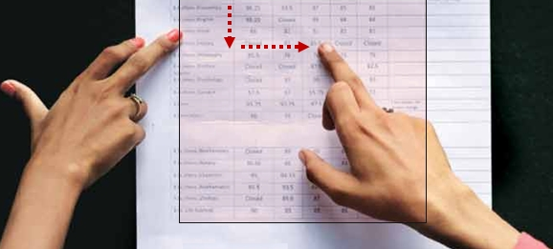

Slide 3
SN | ID | Name | Score
01 | 1222 | Karl | 76
02 | 2134 | Jenny | 56
03 | 2111 | Sam | 42
04 | 2199 | John | 71
05 | 1221 | Carol | 92
06 | 1009 | Ray | 62
ID | Score
2199 | ?


Slide 4
SN | ID | Name | Score
01 | 1222 | Karl | 76
02 | 2134 | Jenny | 56
03 | 2111 | Sam | 42
04 | 2199 | John | 71
05 | 1221 | Carol | 92
06 | 1009 | Ray | 62
ID | Score
2199 | 71

Slide 5
#1
#2
#3
SN | ID | Name | Score
01 | 1222 | Karl | 76
02 | 2134 | Jenny | 56
03 | 2111 | Sam | 42
04 | 2199 | John | 71
05 | 1221 | Carol | 92
06 | 1009 | Ray | 62
ID | Score
2199 | ?
lookup_value
FALSE (0) is for EXACT match
TRUE (1) is for SLABS cases… to be cont’d
table_array with ID as 1st column

